Slide 1


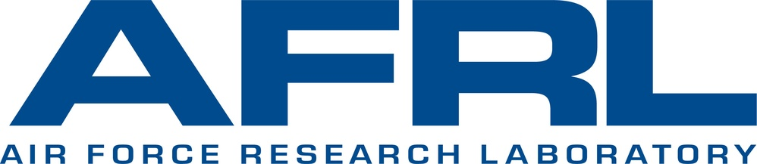

Examining Effects of Post-Processing Operations on Laser Powder Bed Fusion 3D Printed Parts
Molly Auer
Dr. Hannah Budinoff
University of Arizona
Arizona NASA Space Grant Consortium Student Research Symposium
SkySong, Arizona State University Scottsdale Innovation Center
April 19, 2025

Slide 2
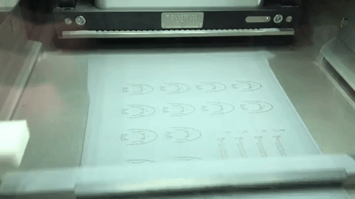
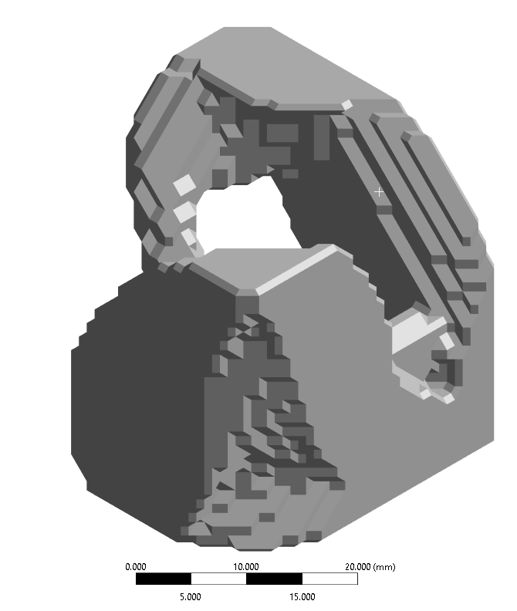
Introduction
Advantages | Disadvantages
Fabricate Complex Geometries | High Residual Stresses
Precisely Distribute Material | Significant Porosity
Compatible with Topology Optimized Parts | High Surface Roughness
Fast | Costly
Laser Powder Bed Fusion (LPBF)
Metal additive manufacturing 3D printing process
Post processing operations, such as heat treatment, can mitigate these issues and enhance structural integrity
Reduce deformation
Relieve residual stresses
Improve material properties
(Hendrixon, 2023)
2

Slide 3
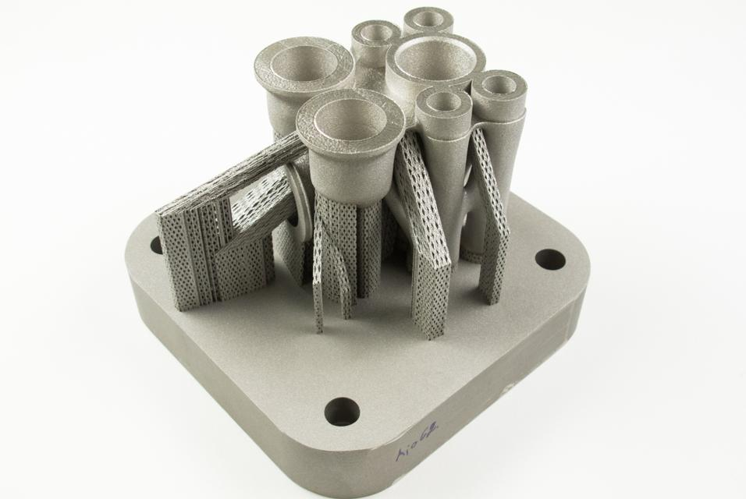
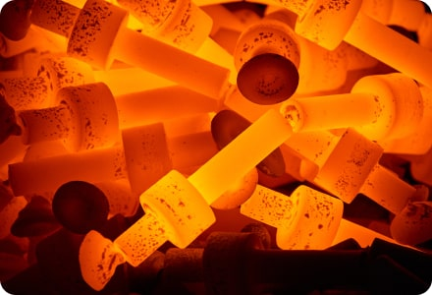
Objectives
Examine effects of post-processing operations on LPBF prints
Provide guidance on optimizing order of operations and processing parameters
Minimize distortion and residual stresses
Increase part manufacturability
Infer how post-processing decisions can increase LPBF manufacturability
Base Unbolting
Base Removal
Support Removal
Heat Treatment
(Materialise, 2024)
(MakerVerse, 2024)
3

Slide 4
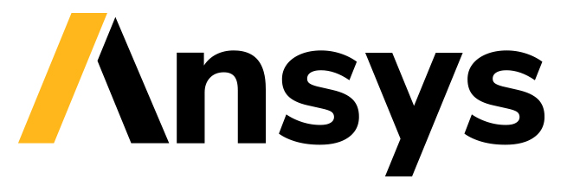
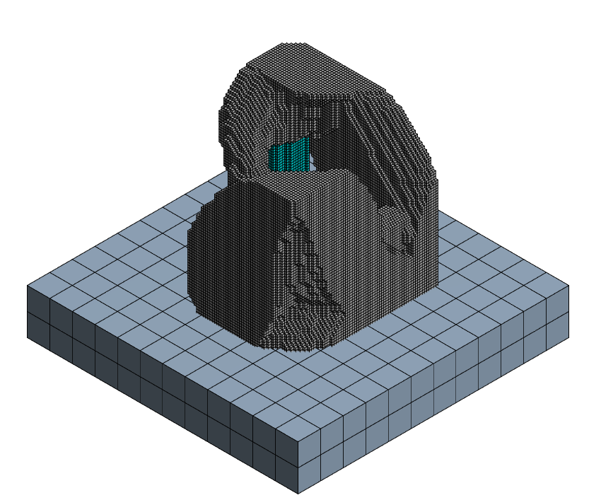
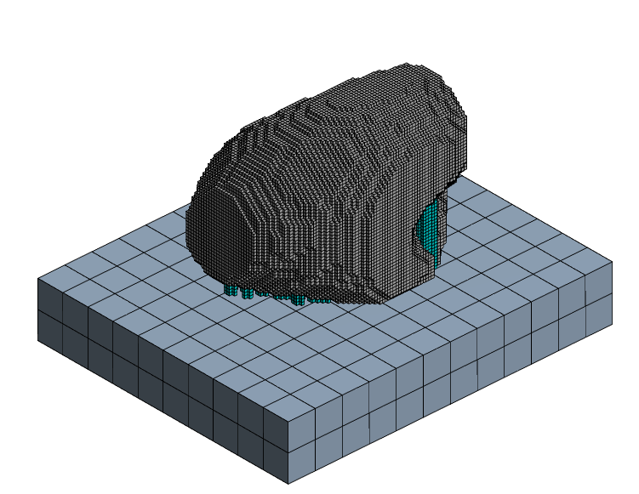
Methodology
Simulated LPBF printing of 2 Topology Optimized Parts
Ansys Mechanical
Titanium alloy (TI-6Al-4V)
0.5 mm mesh
Generated supports and base plate
Part 1
32x32x32 mm
~100K elements
Order | Operation | Simulation Parameters
1 | Base Unbolting | Instantaneous
2 | Base Removal | Directional, 0.5 mm Step Size, Cut at 0◦
3 | Support Removal | Instantaneous
4 | Heat Treatment | Anneal at 850◦C, Heat up 10 minutes, Hold 1 hour, Cooldown 1 hour
Part 2
25x32x28 mm
~130K elements
4

Slide 5
Methodology
Simulated 9 processes per part
Process Number | Operations
1 | None
2 | Base Unbolting
3 | Base Unbolting, Heat Treatment
4 | Base Unbolting, Base Removal
5 | Base Unbolting, Base Removal, Heat Treatment
6 | Base Unbolting, Support Removal
7 | Base Unbolting, Support Removal, Heat Treatment
8 | Base Unbolting, Base Removal, Support Removal
9 | Base Unbolting, Base Removal, Support Removal, Heat Treatment
5

Slide 6
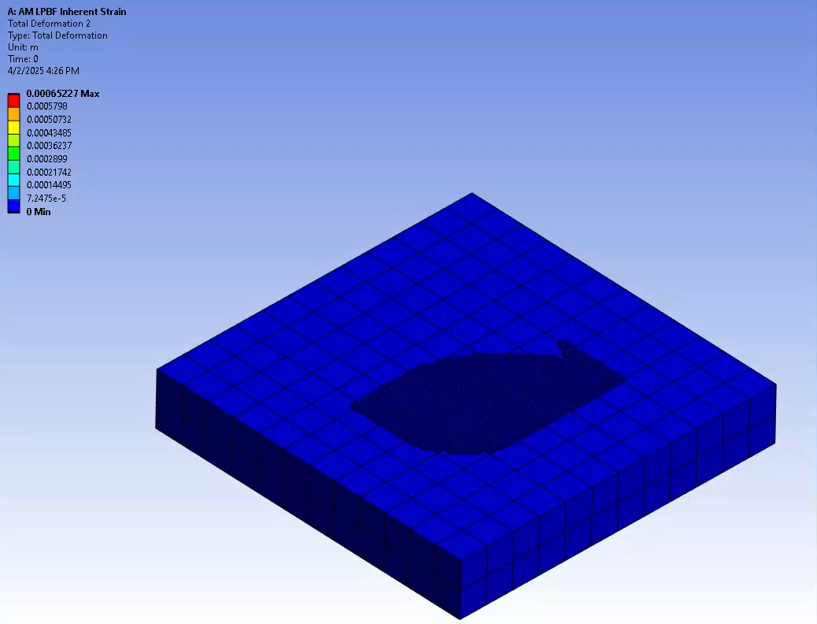
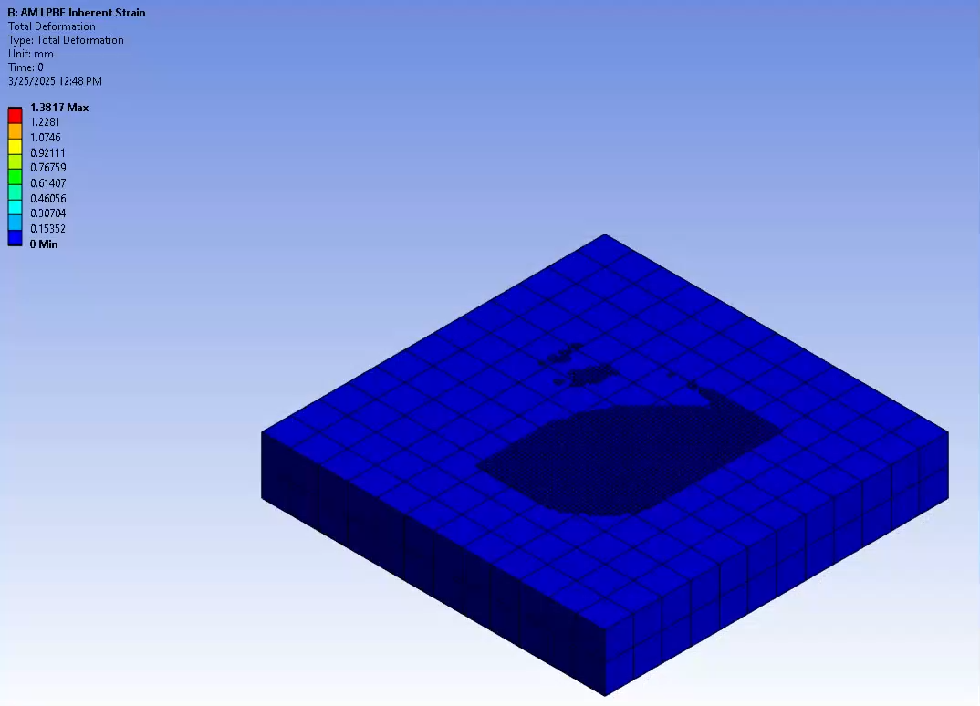
Results
Maximum Deformation Visualization for Part 1
Build, Base Unbolting, Base Removal
Heat Treatment
6

Slide 7
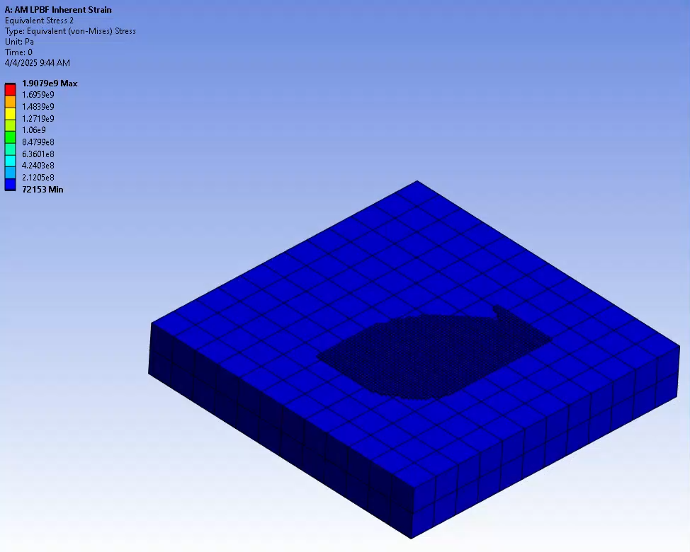
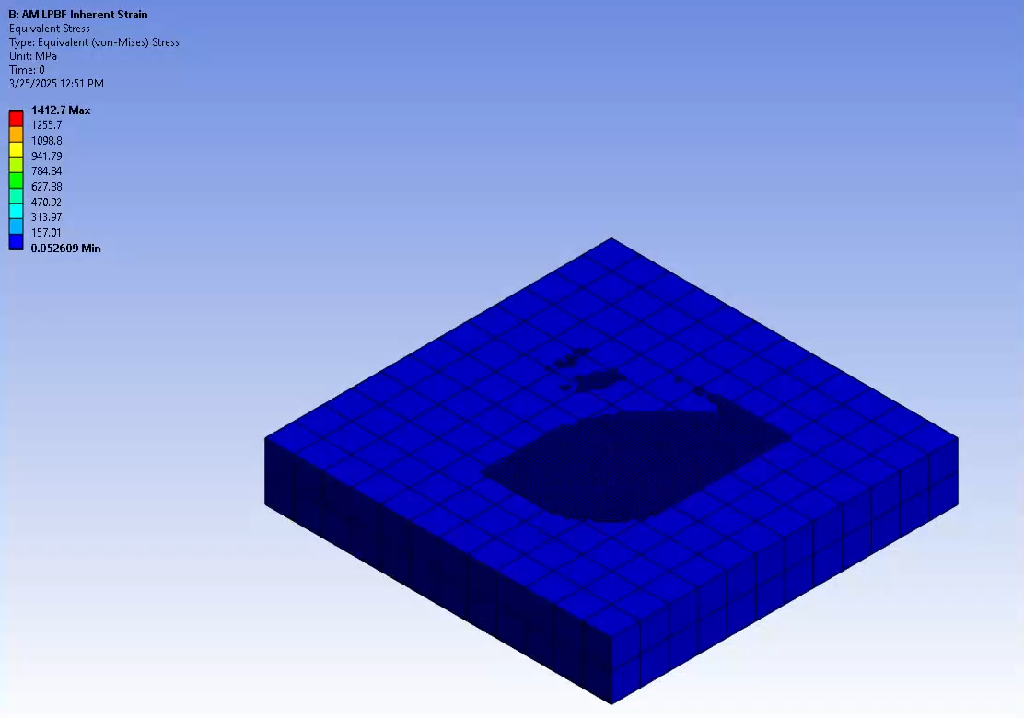
Results
Maximum Residual Stress Visualization for Part 1
Build, Base Unbolting, Base Removal
Heat Treatment
7

Slide 8
Results
Effects of Post Processing Operations
Heat Treatment increased distortion by 34% on average
Scattered Trends across parts and processes
8

Slide 9
Results
Effects of Post Processing Operations
Heat Treatment reduced residual stress by 70% on average
Clear trend that processes involving heat treatment relieved residual stresses
9

Slide 10
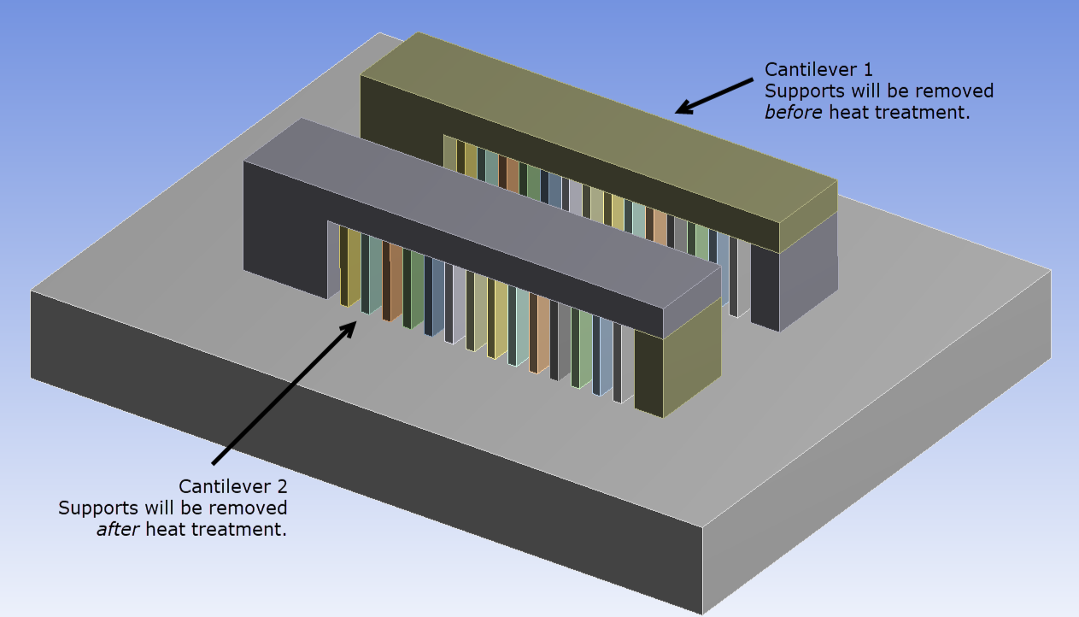
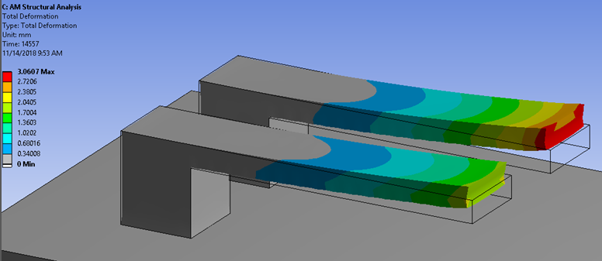
Results and Conclusions
To minimize distortion, heat treatment should be performed:
After Base Unbolting
Before Base and Support Removal
After Base and Support Removal
Ideal Order of Operations:
Base Unbolting
Heat Treatment
Base Removal
Support Removal
Heat Treatment
(Ansys Help, 2024)
10

Slide 11
Results and Conclusions
Ideal Process Parameters
Heat Treatment:
Time
Slow ramp and cooling time (5-10 ◦C/min) to prevent harmful thermal gradients and improve ductility
Shorter hold times (0.5-2hr) for higher temperatures (800-1000◦C)
Longer hold times (2-5hr) for lower temperatures (400-800◦C)
Temperature
Lower temperatures (400-800◦C) to balance strength and ductility
Higher temperatures (800-1000◦C) to increase toughness and strength
Base Removal:
Step Size
Smaller step size (<0.5 mm) for smoother detachment, lower efficiency
Larger step size (>0.5 mm) for coarser removal, higher efficiency
Direction
0◦ for a smooth horizontal removal
>0◦ for more aggressive material removal
Ideal with support raft to prevent damaging part itself
(Laleh, 2023)
11

Slide 12
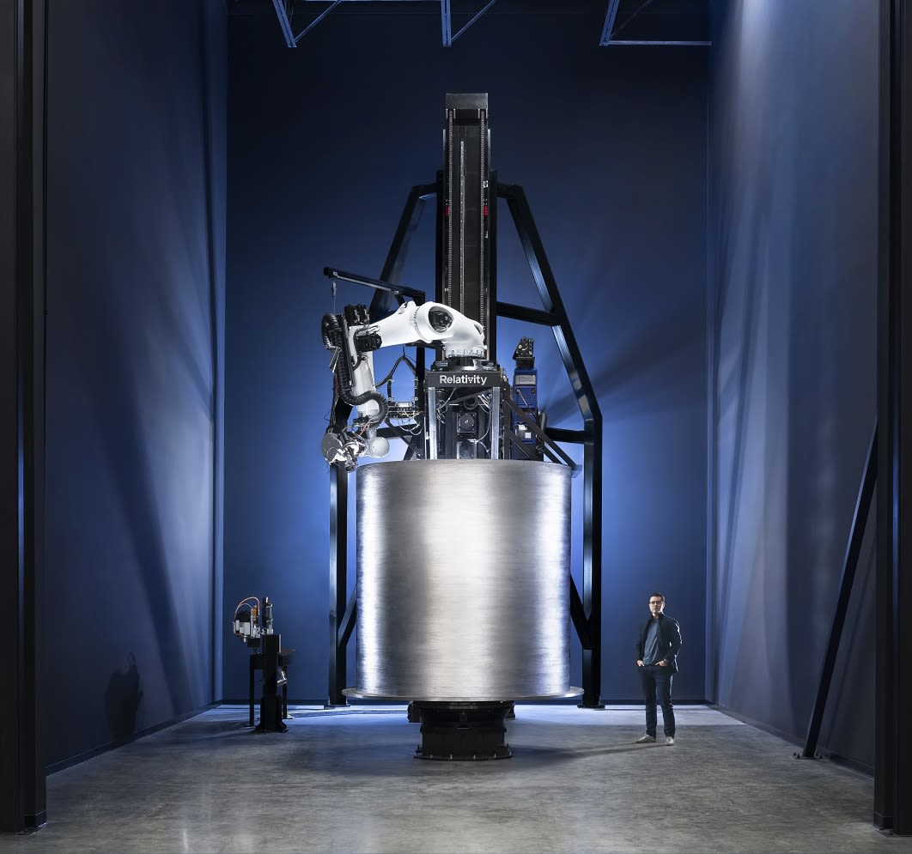
Future Implications
Future Studies
Different parts
Different materials
Different part sizes
Data after heat treatment (Ansys bug)
Advance Additive Manufacturing
Relativity Space’s 3D printed rocket
(Sheetz, 2020)
12

Slide 13
References
Ansys Help. (2024). Simulating Heat Treatment after the Build.
https://ansyshelp.ansys.com/account/secured?returnurl=/Views/Secured/corp/v241/en/add_ag/add_ag_adv_top_heat_treat.html
Hendrixson, S. (2023, July 26). What is Powder Bed Fusion 3D Printing? Gardner Business Media, Inc.
https://www.additivemanufacturing.media/articles/am-101-powder-bed-fusion-pbf
Laleh, M., et al. (2023). Heat treatment for metal additive manufacturing. Progress in Materials Science.
https://www.sciencedirect.com/science/article/pii/S0079642522001323
MakerVerse. (2024, October 16). Laser Powder Bed Fusion (LPBF). MakerVerse.
https://www.makerverse.com/offering/laser-powder-bed-fusion-lpbf/
Materialise. (2024, November 14). 5 easy ways to remove metal support structures.
https://www.materialise.com/en/inspiration/articles/5-ways-to-remove-metal-support-structures
Sheetz, M. (2020, October 8). Inside Relativity Space’s 3D-printing rocket “factory of the future.” CNBC.
https://www.cnbc.com/2020/10/07/inside-relativity-space-hq-3d-printer-rocket-factory-of-the-future.html
13

Slide 14
Acknowledgements
Special thanks to:
Dr. Hannah Budinoff, Principal Investigator and Mentor
Juan Machado Jr, Intern Advisor
Nathan Hertlein, Project Advisor
Arizona NASA Space Grant
Air Force Research Laboratory
University of Arizona, Systems and Industrial Engineering
Manufacturing and Design Exploration Lab: https://sites.arizona.edu/made-lab/
This material is based on research sponsored by the Air Force Research Laboratory under agreement number FA8650-20-2-5853. The U.S. Government is authorized to reproduce and distribute reprints for Governmental purposes notwithstanding any copyright notation thereon. The views and conclusions contained herein are those of the authors and should not be interpreted as necessarily representing the official policies or endorsements, either expressed or implied, of the Air Force Research Laboratory or the U.S. Government.
14

Slide 15
Thank you!

